Slide 1
Chapter 8: Object-Oriented Databases
Need for Complex Data Types
The Object-Oriented Data Model
Object-Oriented Languages
Persistent Programming Languages
Persistent C++ Systems

Slide 2
Need for Complex Data Types
Traditional database applications in data processing had conceptually simple data types
  Relatively few data types, first normal form holds
Complex data types have grown more important in recent years
  E.g. Addresses can be viewed as a
    Single string, or
    Separate attributes for each part, or
    Composite attributes (which are not in first normal form)
  E.g. it is often convenient to store multivalued attributes as-is, without creating a separate relation to store the values in first normal form
Applications
  computer-aided design, computer-aided software engineering
  multimedia and image databases, and document/hypertext databases.

Slide 3
Object-Oriented Data Model
Loosely speaking, an object corresponds to an entity in the E-R model.
The object-oriented paradigm is based on encapsulating code and data related to an object into single unit.
The object-oriented data model is a logical data model (like the E-R model).
Adaptation of the object-oriented programming paradigm (e.g., Smalltalk, C++) to database systems.

Slide 4
Object Structure
An object has associated with it:
  A set of variables that contain the data for the object. The value of each variable is itself an object.
  A set of messages to which the object responds; each message may have zero, one, or more parameters.
  A set of methods, each of which is a body of code to implement a message; a method returns a value as the response to the message
The physical representation of data is visible only to the implementor of the object
Messages and responses provide the only external interface to an object.
The term message does not necessarily imply physical message passing. Messages can be implemented as procedure invocations.

Slide 5
Messages and Methods
Methods are programs written in general-purpose language with the following features
  only variables in the object itself may be referenced directly
  data in other objects are referenced only by sending messages.
Methods can be read-only or update methods
  Read-only methods do not change the value of the object
Strictly speaking, every attribute of an entity must be represented by a variable and two methods, one to read and the other to update the attribute
  e.g., the attribute address is represented by a variable address and two messages get-address and set-address.
  For convenience, many object-oriented data models permit direct access to variables of other objects.

Slide 6
Object Classes
Similar objects are grouped into a class; each such object is called an instance of its class
All objects in a class have the same
  Variables, with the same types
  message interface
  methods
  The may differ in the values assigned to variables
Example: Group objects for people into a person class
Classes are analogous to entity sets in the E-R model

Slide 7
Class Definition Example
class employee {
/*Variables */
string name;
string address;
date start-date;
int salary;
/* Messages */
int annual-salary();
string get-name();
string get-address();
int set-address(string new-address);
int employment-length();
};
Methods to read and set the other variables are also needed with strict encapsulation
Methods are defined separately
  E.g. int employment-length() { return today() – start-date;}
  int set-address(string new-address) { address = new-address;}

Slide 8
Inheritance
E.g., class of bank customers is similar to class of bank employees, although there are differences
  both share some variables and messages, e.g., name and address.
  But there are variables and messages specific to each class e.g., salary for employees and credit-rating for customers.
Every employee is a person; thus employee is a specialization of person
Similarly, customer is a specialization of person.
Create classes person, employee and customer
  variables/messages applicable to all persons associated with class person.
  variables/messages specific to employees associated with class employee; similarly for customer

Slide 9
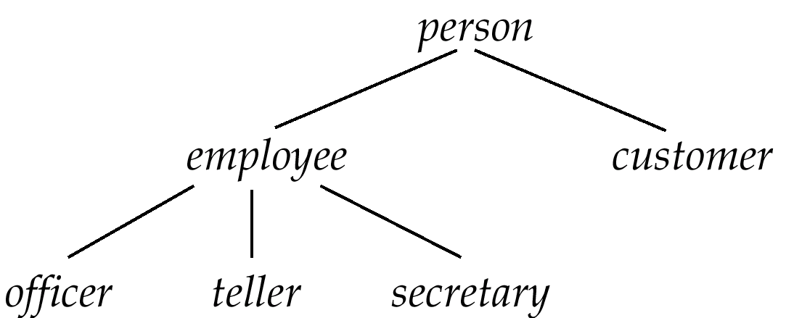
Inheritance (Cont.)
Place classes into a specialization/IS-A hierarchy
  variables/messages belonging to class person are inherited by class employee as well as customer
Result is a class hierarchy
Note analogy with ISA Hierarchy in the E-R model

Slide 10
Class Hierarchy Definition
class person{
string name;
string address:
};
class customer isa person {
int credit-rating;
};
class employee isa person {
date start-date;
int salary;
};
class officer isa employee {
int office-number,
int expense-account-number,
};
.
.
.

Slide 11
Class Hierarchy Example (Cont.)
Full variable list for objects in the class officer:
  office-number, expense-account-number: defined locally
  start-date, salary: inherited from employee
  name, address: inherited from person
Methods inherited similar to variables.
Substitutability — any method of a class, say person, can be invoked equally well with any object belonging to any subclass, such as subclass officer of person.
Class extent: set of all objects in the class. Two options:
  1. Class extent of employee includes all officer, teller and secretary objects.
  Class extent of employee includes only employee objects that are not in a subclass such as officer, teller, or secretary
    This is the usual choice in OO systems
    Can access extents of subclasses to find all objects of
    subtypes of employee

Slide 12
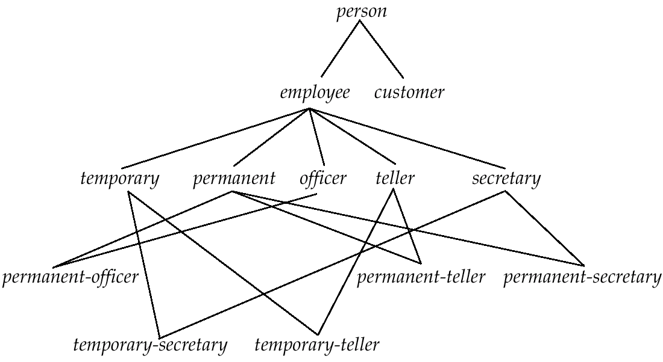
Example of Multiple Inheritance
Class DAG for banking example.

Slide 13
Multiple Inheritance
With multiple inheritance a class may have more than one superclass.
  The class/subclass relationship is represented by a directed acyclic graph (DAG)
  Particularly useful when objects can be classified in more than one way, which are independent of each other
    E.g. temporary/permanent is independent of Officer/secretary/teller
    Create a subclass for each combination of subclasses
      Need not create subclasses for combinations that are not possible in the database being modeled
A class inherits variables and methods from all its superclasses
There is potential for ambiguity when a variable/message N with the same name is inherited from two superclasses A and B
  No problem if the variable/message is defined in a shared superclass
  Otherwise, do one of the following
    flag as an error,
    rename variables (A.N and B.N)
    choose one.

Slide 14
More Examples of Multiple Inheritance
Conceptually, an object can belong to each of several subclasses
  A person can play the roles of student, a teacher or footballPlayer, or any combination of the three
    E.g., student teaching assistant who also play football
Can use multiple inheritance to model “roles” of an object
  That is, allow an object to take on any one or more of a set of types
But many systems insist an object should have a most-specific class
  That is, there must be one class that an object belongs to which is a subclass of all other classes that the object belongs to
  Create subclasses such as student-teacher and
  student-teacher-footballPlayer for each combination
  When many combinations are possible, creating
  subclasses for each combination can become cumbersome

Slide 15
Object Identity
An object retains its identity even if some or all of the values of variables or definitions of methods change over time.
Object identity is a stronger notion of identity than in programming languages or data models not based on object orientation.
  Value – data value; e.g. primary key value used in relational systems.
  Name – supplied by user; used for variables in procedures.
  Built-in – identity built into data model or programming language.
    no user-supplied identifier is required.
    Is the form of identity used in object-oriented systems.

Slide 16
Object Identifiers
Object identifiers used to uniquely identify objects
  Object identifiers are unique:
    no two objects have the same identifier
    each object has only one object identifier
  E.g., the spouse field of a person object may be an identifier of another person object.
  can be stored as a field of an object, to refer to another object.
  Can be
    system generated (created by database) or
    external (such as social-security number)
  System generated identifiers:
    Are easier to use, but cannot be used across database systems
    May be redundant if unique identifier already exists

Slide 17
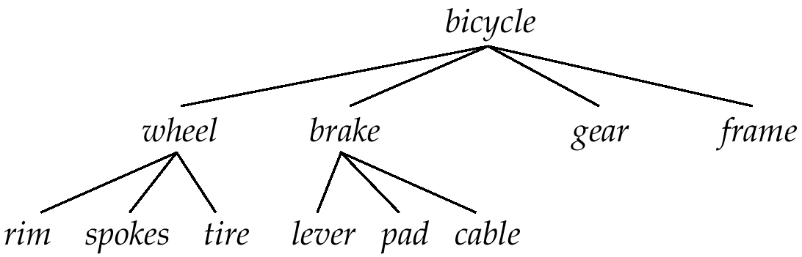
Object Containment
Each component in a design may contain other components
Can be modeled as containment of objects. Objects containing; other objects are called composite objects.
Multiple levels of containment create a containment hierarchy
  links interpreted as is-part-of, not is-a.
Allows data to be viewed at different granularities by different users.

Slide 18
Object-Oriented Languages
Object-oriented concepts can be used in different ways
  Object-orientation can be used as a design tool, and be encoded into, for example, a relational database
    analogous to modeling data with E-R diagram and then converting to a set of relations)
  The concepts of object orientation can be incorporated into a programming language that is used to manipulate the database.
    Object-relational systems – add complex types and object-orientation to relational language.
    Persistent programming languages – extend object-oriented programming language to deal with databases by adding concepts such as persistence and collections.

Slide 19
Persistent Programming Languages
Persistent Programming languages allow objects to be created and stored in a database, and used directly from a programming language
  allow data to be manipulated directly from the programming language
    No need to go through SQL.
  No need for explicit format (type) changes
    format changes are carried out transparently by system
    Without a persistent programming language, format changes becomes a burden on the programmer
      More code to be written
      More chance of bugs
  allow objects to be manipulated in-memory
    no need to explicitly load from or store to the database
      Saved code, and saved overhead of loading/storing large amounts of data

Slide 20
Persistent Prog. Languages (Cont.)
Drawbacks of persistent programming languages
  Due to power of most programming languages, it is easy to make programming errors that damage the database.
  Complexity of languages makes automatic high-level optimization more difficult.
  Do not support declarative querying as well as relational databases

Slide 21
Persistence of Objects
Approaches to make transient objects persistent include establishing
  Persistence by Class – declare all objects of a class to be persistent; simple but inflexible.
  Persistence by Creation – extend the syntax for creating objects to specify that that an object is persistent.
  Persistence by Marking – an object that is to persist beyond program execution is marked as persistent before program termination.
  Persistence by Reachability - declare (root) persistent objects; objects are persistent if they are referred to (directly or indirectly) from a root object.
    Easier for programmer, but more overhead for database system
    Similar to garbage collection used e.g. in Java, which
    also performs reachability tests

Slide 22
Object Identity and Pointers
A persistent object is assigned a persistent object identifier.
Degrees of permanence of identity:
  Intraprocedure – identity persists only during the executions of a single procedure
  Intraprogram – identity persists only during execution of a single program or query.
  Interprogram – identity persists from one program execution to another, but may change if the storage organization is changed
  Persistent – identity persists throughout program executions and structural reorganizations of data; required for object-oriented systems.

Slide 23
Object Identity and Pointers (Cont.)
In O-O languages such as C++, an object identifier is actually an in-memory pointer.
Persistent pointer – persists beyond program execution
  can be thought of as a pointer into the database
    E.g. specify file identifier and offset into the file
  Problems due to database reorganization have to be dealt with by keeping forwarding pointers

Slide 24
Storage and Access of Persistent Objects
How to find objects in the database:
Name objects (as you would name files)
  Cannot scale to large number of objects.
  Typically given only to class extents and other collections of objects, but not objects.
Expose object identifiers or persistent pointers to the objects
  Can be stored externally.
  All objects have object identifiers.
Store collections of objects, and allow programs to iterate over the collections to find required objects
  Model collections of objects as collection types
  Class extent - the collection of all objects belonging to the class; usually maintained for all classes that can have persistent objects.

Slide 25
Persistent C++ Systems
C++ language allows support for persistence to be added without changing the language
  Declare a class called Persistent_Object with attributes and methods to support persistence
  Overloading – ability to redefine standard function names and operators (i.e., +, –, the pointer deference operator –>) when applied to new types
  Template classes help to build a type-safe type system supporting collections and persistent types.
Providing persistence without extending the C++ language is
  relatively easy to implement
  but more difficult to use
Persistent C++ systems that add features to the C++ language have been built, as also systems that avoid changing the
language

Slide 26
ODMG C++ Object Definition Language
The Object Database Management Group is an industry consortium aimed at standardizing object-oriented databases
  in particular persistent programming languages
  Includes standards for C++, Smalltalk and Java
  ODMG-93
  ODMG-2.0 and 3.0 (which is 2.0 plus extensions to Java)
    Our description based on ODMG-2.0
ODMG C++ standard avoids changes to the C++ language
  provides functionality via template classes and class libraries

Slide 27
ODMG Types
Template class d_Ref<class> used to specify references (persistent pointers)
Template class d_Set<class> used to define sets of objects.
  Methods include insert_element(e) and delete_element(e)
Other collection classes such as d_Bag (set with duplicates allowed), d_List and d_Varray (variable length array) also provided.
d_ version of many standard types provided, e.g. d_Long and d_string
  Interpretation of these types is platform independent
  Dynamically allocated data (e.g. for d_string) allocated in the database, not in main memory

Slide 28
ODMG C++ ODL: Example
class Branch : public d_Object {
….
}
class Person : public d_Object {
public:
d_String name; // should not use String!
d_String address;
};
class Account : public d_Object {
private:
d_Long balance;
public:
d_Long number;
d_Set <d_Ref<Customer>> owners;
int find_balance();
int update_balance(int delta);
};

Slide 29
ODMG C++ ODL: Example (Cont.)
class Customer : public Person {
public:
d_Date member_from;
d_Long customer_id;
d_Ref<Branch> home_branch;
d_Set <d_Ref<Account>> accounts; };

Slide 30
Implementing Relationships
Relationships between classes implemented by references
Special reference types enforces integrity by adding/removing inverse links.
  Type d_Rel_Ref<Class, InvRef> is a reference to Class, where attribute InvRef of Class is the inverse reference.
  Similarly, d_Rel_Set<Class, InvRef> is used for a set of references
Assignment method (=) of class d_Rel_Ref is overloaded
  Uses type definition to automatically find and update the inverse link
  Frees programmer from task of updating inverse links
  Eliminates possibility of inconsistent links
Similarly, insert_element() and delete_element() methods of d_Rel_Set use type definition to find and update the inverse link automatically

Slide 31
Implementing Relationships
E.g.
extern const char _owners[ ], _accounts[ ];
class Account : public d.Object {
….
d_Rel_Set <Customer, _accounts> owners;
}
// .. Since strings can’t be used in templates …
const char _owners= “owners”;
const char _accounts= “accounts”;

Slide 32
ODMG C++ Object Manipulation Language
Uses persistent versions of C++ operators such as new(db)
d_Ref<Account> account = new(bank_db, “Account”) Account;
  new allocates the object in the specified database, rather than in memory.
  The second argument (“Account”) gives typename used in the database.
Dereference operator -> when applied on a d_Ref<Account> reference loads the referenced object in memory (if not already present) before continuing with usual C++ dereference.
Constructor for a class – a special method to initialize objects when they are created; called automatically on new call.
Class extents maintained automatically on object creation and deletion
  Only for classes for which this feature has been specified
    Specification via user interface, not C++
  Automatic maintenance of class extents not supported in
  earlier versions of ODMG

Slide 33
ODMG C++OML: Database and Object Functions
Class d_Database provides methods to
  open a database: open(databasename)
  give names to objects: set_object_name(object, name)
  look up objects by name: lookup_object(name)
  rename objects: rename_object(oldname, newname)
  close a database (close());
Class d_Object is inherited by all persistent classes.
  provides methods to allocate and delete objects
  method mark_modified() must be called before an object is updated.
    Is automatically called when object is created

Slide 34
ODMG C++ OML: Example
int create_account_owner(String name, String Address){
Database bank_db.obj;
Database * bank_db= & bank_db.obj;
bank_db =>open(“Bank-DB”);
d.Transaction Trans;
Trans.begin();
d_Ref<Account> account = new(bank_db) Account;
d_Ref<Customer> cust = new(bank_db) Customer;
cust->name - name;
cust->address = address;
cust->accounts.insert_element(account);
... Code to initialize other fields
Trans.commit();
}

Slide 35
ODMG C++ OML: Example (Cont.)
Class extents maintained automatically in the database.
To access a class extent:
d_Extent<Customer> customerExtent(bank_db);
Class d_Extent provides method
d_Iterator<T> create_iterator()
to create an iterator on the class extent
Also provides select(pred) method to return iterator on objects that satisfy selection predicate pred.
Iterators help step through objects in a collection or class extent.
Collections (sets, lists etc.) also provide create_iterator() method.

Slide 36
ODMG C++ OML: Example of Iterators
int print_customers() {
Database bank_db_obj;
Database * bank_db = &bank_db_obj;
bank_db->open (“Bank-DB”);
d_Transaction Trans; Trans.begin ();
d_Extent<Customer> all_customers(bank_db);
d_Iterator<d_Ref<Customer>> iter;
iter = all_customers–>create_iterator();
d_Ref <Customer> p;
while{iter.next (p))
print_cust (p); // Function assumed to be defined elsewhere
Trans.commit();
}

Slide 37
ODMG C++ Binding: Other Features
Declarative query language OQL, looks like SQL
  Form query as a string, and execute it to get a set of results (actually a bag, since duplicates may be present)
d_Set<d_Ref<Account>> result;
d_OQL_Query q1("select a
from Customer c, c.accounts a
where c.name=‘Jones’
and a.find_balance() > 100");
d_oql_execute(q1, result);
Provides error handling mechanism based on C++ exceptions, through class d_Error
Provides API for accessing the schema of a database.

Slide 38
Making Pointer Persistence Transparent
Drawback of the ODMG C++ approach:
  Two types of pointers
  Programmer has to ensure mark_modified() is called, else database can become corrupted
ObjectStore approach
  Uses exactly the same pointer type for in-memory and database objects
  Persistence is transparent applications
    Except when creating objects
  Same functions can be used on in-memory and persistent objects since pointer types are the same
  Implemented by a technique called pointer-swizzling which is described in Chapter 11.
  No need to call mark_modified(), modification detected automatically.

Slide 39
Persistent Java Systems
ODMG-3.0 defines extensions to Java for persistence
  Java does not support templates, so language extensions are required
Model for persistence: persistence by reachability
  Matches Java’s garbage collection model
  Garbage collection needed on the database also
  Only one pointer type for transient and persistent pointers
Class is made persistence capable by running a post-processor on object code generated by the Java compiler
  Contrast with pre-processor used in C++
  Post-processor adds mark_modified() automatically
Defines collection types DSet, DBag, DList, etc.
Uses Java iterators, no need for new iterator class

Slide 40
ODMG Java
Transaction must start accessing database from one of the root object (looked up by name)
  finds other objects by following pointers from the root objects
Objects referred to from a fetched object are allocated space in memory, but not necessarily fetched
  Fetching can be done lazily
  An object with space allocated but not yet fetched is called a hollow object
  When a hollow object is accessed, its data is fetched from disk.

Slide 41
End of Chapter

Slide 42
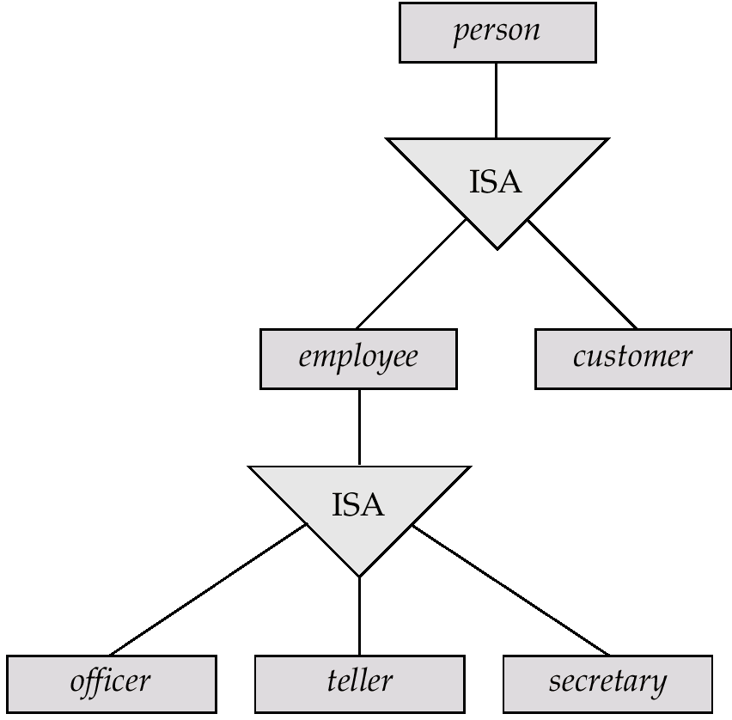
Specialization Hierarchy for the Bank Example

Slide 43
Class Hierarchy Corresponding to Figure 8.2

Slide 44
Class DAG for the Bank Example

Slide 45
Containment Hierarchy for Bicycle-Design Database

